Slide 1
Dynamic Feature Integration For Simultaneous Detection Of Salient Object, Edge And Skeleton - Mini Project 1st Review
Bellamkonda Chandra Sekhar 122003049 - CSE
Sai Aditya Viswanadham 122003291 - CSE Guide – B. Karthikeyan
Auti Karthik 122014006 - ICT

Slide 2
ACKNOWLEDGEMENTS
Firstly, I would be grateful for the management and faculty for their huge efforts of smooth running of Academics without any hurdles in this pandemic situation.
I would specially thank and express my gratitude to Prof. Karthikeyan .B, Senior Assistant Professor, School of Computing for providing us an opportunity to do this project and for his overwhelming support and guidance.
Finally, I thank God Almighty for his endless blessings and my parents who help me acquire this interest in project and aided me in completing it within the deadline without much struggle.

Slide 3
BASE PAPER DETAILS
IEEE Link: https://ieeexplore.ieee.org/document/9178497
Publisher: IEEE
Date of Publication: 26 August 2020
ISSN / eISSN: 1057-7149 / 1941-0042
Web of Science Core Collection: Science Citation Index Expanded(SCI-E)
J. -J. Liu, Q. Hou and M. -M. Cheng, "Dynamic Feature Integration for Simultaneous Detection of Salient Object, Edge, and Skeleton," in IEEE Transactions on Image Processing, vol. 29, pp. 8652-8667, 2020, doi: 10.1109/TIP.2020.3017352.

Slide 4
PROBLEM STATEMENT
The rapid use and popularization of mobile devices have made many computer vision and deep learning applications to act as fundamental components running in background to improve mobile photography and in turn provide real-time effects previews.
Salient object segmentation task makes use of depth information in order to simulate the bokeh effect and by obtaining structure information edge detection helps taking pictures with more visual pleasing compositions , skeleton extraction supports gestures.
The three low-level pixel-wise vision issues of salient object segmentation, edge detection, and skeleton extraction are three different low-level pixel-wise vision difficulties, with most existing work focusing on designing customized techniques for each unique job.

Slide 5
PROBLEM STATEMENT CONTD.
Due to it’s threshold in computing and storage it is inefficient to perform this three different tasks sequentially and storing pre-trained models for every different application.
We offer a selective integration module in particular, which allows each job to dynamically choose features from the shared backbone at different levels based on its unique characteristics.
In addition, we create a task-adaptive attention module with the goal of appropriately distributing information for various activities based on picture content priors. We undertake extensive experiments on several sample datasets to evaluate the performance of our proposed network on these tasks.

Slide 6
LITERATURE SURVEY
Qibin Hou worked on creating a framework that takes full advantage of multilevel and multi-scale features extracted from FCN’s, providing more advanced representations to perform segment detection.
Cheng worked on how computer vision techniques benefit computer graphics techniques and vice versa, and cover research on analysis, manipulation, synthesis, and interaction.
Wang proposed a new end-to-end Multi-Scale Convolutional Features (MSCF) network to integrate the dilated convolution and rich convolutional features extracted from the intermediate layers of traditional CNN.

Slide 7
LITERATURE SURVEY CONTD.
Kai Zhao proposed CNN-based approach has a powerful multi-scale feature integration ability that intrinsically captures high-level semantics from deeper layers as well as low-level details from shallower layers.
Kokinos addressed two main technical challenges that emerge when broadening up the range of tasks handled by a single CNN, training a deep architecture while relying on diverse training sets and training many (potentially unlimited) tasks with a limited memory budget.

Slide 8
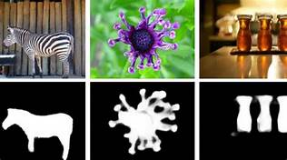
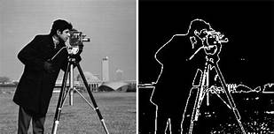
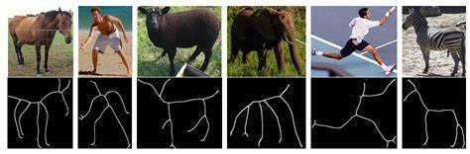
WORK PLAN
Salient Segmentation Edge Detection Skeleton Extraction

Slide 9
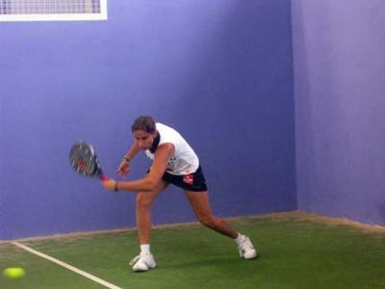

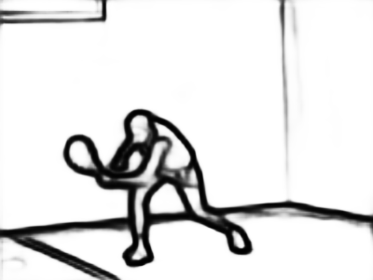
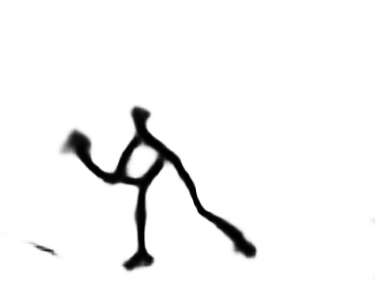

Slide 10
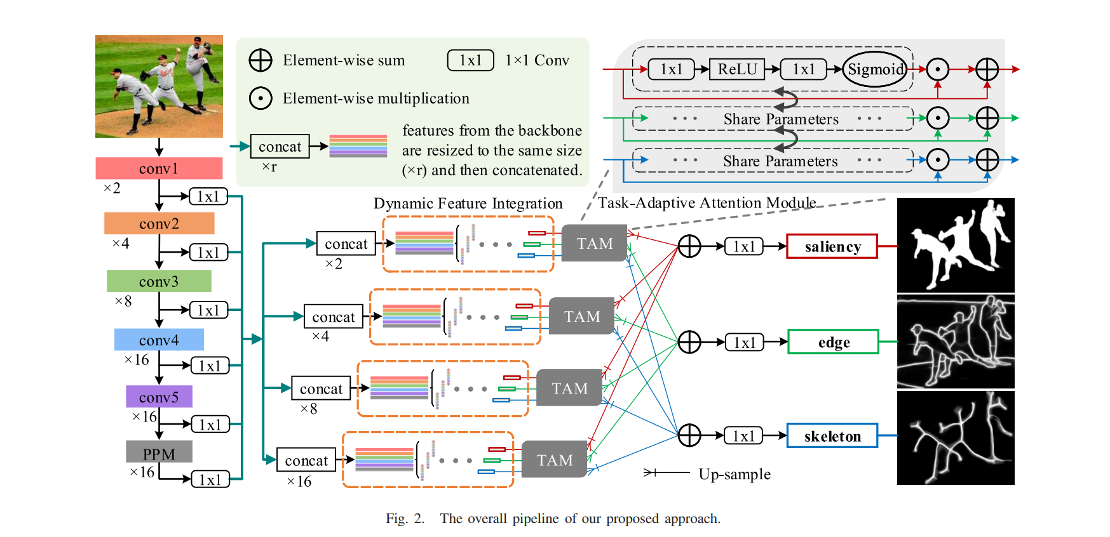
ARCHITECTURAL OVERVIEW

Slide 11
WORK PLAN contd.
The main aim of our model is to simplify the procedure for salient object segementation, edge detection and skeleton detection.
To acheive this we have to train our model using datasets with different set of annotations but this requires a large amount of storage.
To overcome this we are going to combine the three operations to be done at different levels of our training.
To do this we are going to use dynamic feature integration using the gating mechanism.
Gating mechanism is nothing but a gater network to select filters from the backbone network, while design a soft gating mechanism that allowed each neuron to adaptively adjust its receptive field size.

Slide 12
WORK PLAN contd.
Advantages:
DFI can run at 57 FPS in single-task mode and 40 FPS in multi-task mode which is comparable to other methods while producing better detection results.
It takes about 30 hours for the proposed method to be trained while 25 hours for the baseline method. With about 20% more training time introduced by additional parameters in DFIM and TAM, the proposed method has much better and balanced overall performances across all tasks.

Slide 13
WORK CARRIED
Established Source Control System - https://github.com/Mini-Project-Machine-Learning/Workspace
Started Building the Unified Framework.
Understood the role of Dynamic Feature Integration Module.
Worked on Backbone and Task Branches.
Currently working on Integrating smaller modules and Training the Model with the Datasets.

Slide 14
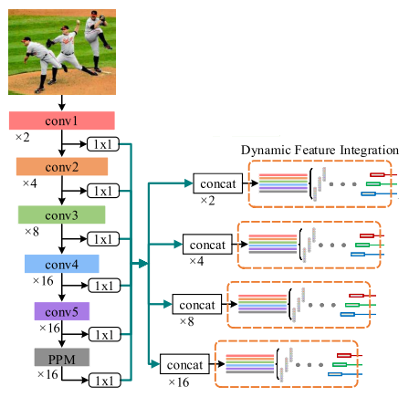

Slide 15
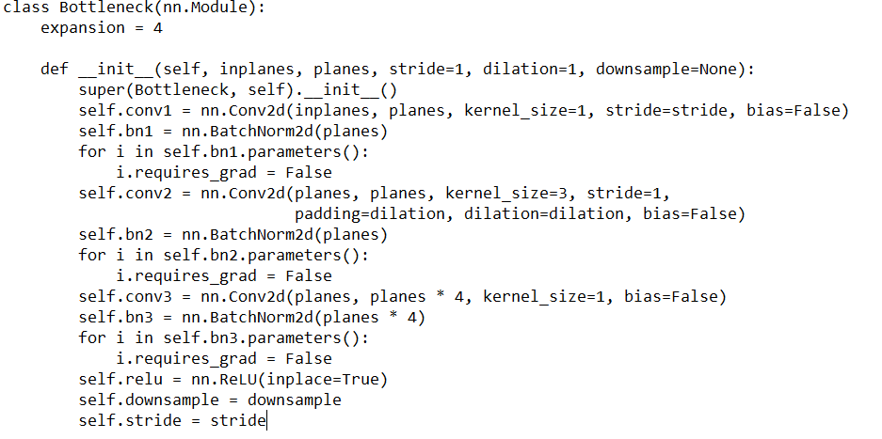
BOTTLENECK

Slide 16
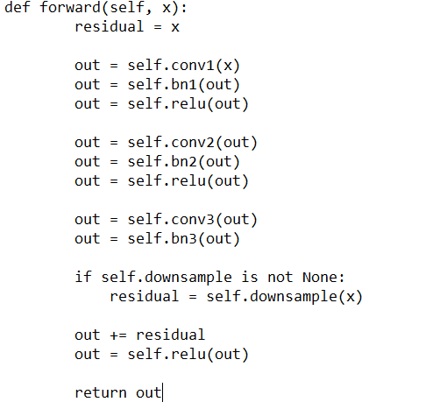
BOTTLENECK CONTD.

Slide 17
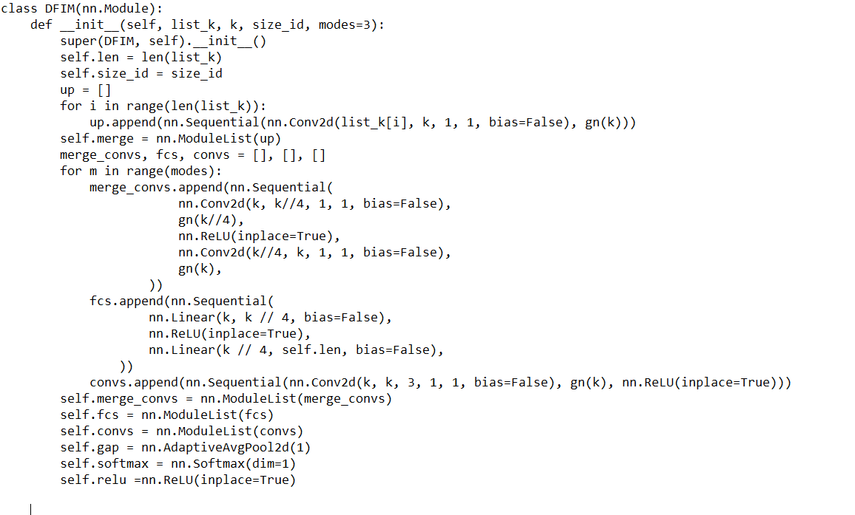
DYNAMIC FEATURE INTEGRATION MODULE

Slide 18
THANKYOU
“ Aim Bigger- Achieve Bigger”

